Slide 1

World Happiness: why India ranks 136th ?
Presented by: Vanshika Saxena

Slide 2
Table of Content
World Happiness :Why India ranks 136th
World Happiness Report
Indicators of World Happiness Report
Result of World Happiness Report
Let’s Analyse India’s Situation
Conclusion

Slide 3
World Happiness Report
The World Happiness Report is a landmark survey of the state of global happiness
The reports review the state of happiness in the world today and show how the new science of happiness explains personal and national variations in happiness.
The happiness scores and rankings use data from the Gallup World Poll.
This year marks the 10th anniversary of the World Happiness Report, which uses global survey data to report how people evaluate their own lives in more than 150 countries worldwide..

Slide 4
World Happiness Report
The World Happiness Report 2022 reveals a bright light in dark times. The pandemic brought not only pain and suffering but also an increase in social support and benevolence.
As we battle the ills of disease and war, it is essential to remember the universal desire for happiness and the capacity of individuals to rally to each other’s support in times of great need.

Slide 5
Indicators of World Happiness Report
The rankings are based on polling (Gallup World Poll) which looks at six variables:
Gross Domestic Product Per Capita (Purchasing Power Parity).
Social Support.
Healthy life expectancy at birth.
Freedom to make life choices.
Generosity.
Perceptions of corruption.
Respondents are asked to rate their own current lives on a 0-10 scale.

Slide 6
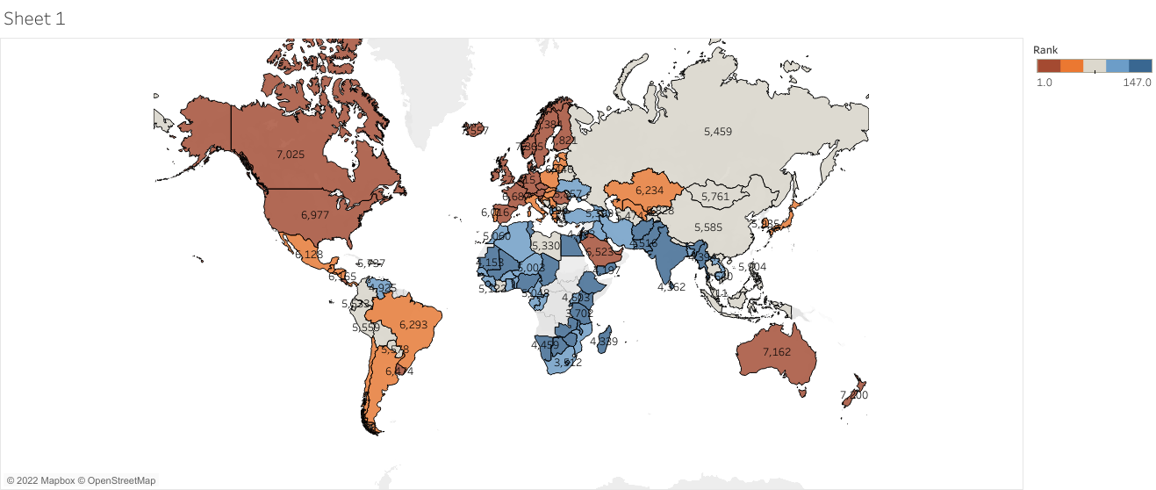
Result of World Happiness Report

Slide 7
Result of World Happiness Report
Finland topped the list for the fifth time in a row, according to the 10th edition of the World Happiness Report.
Finland was followed by Denmark, Iceland, Switzerland, and the Netherlands.
Among other western countries, while the United States managed to bag the 16th position, Britain was ranked 17th and France 20th.
India continued to fare poorly in the world happiness index, with its position marginally improving to 136 as against last year’s 139.
Among the South Asian nations, only Taliban-ruled Afghanistan fared worse than India.
Afghanistan was named the most unhappy country in the world, ranking last on the index of 146 countries.
Nepal (84), Bangladesh (94), Pakistan (121) and Sri Lanka (127) managed to get better ranks in the list.
The Happiness report also stated that India was one among the countries that witnessed, over the past 10 years, a fall in life evaluations by more than a full point on the 0 to 10 scale.

Slide 8
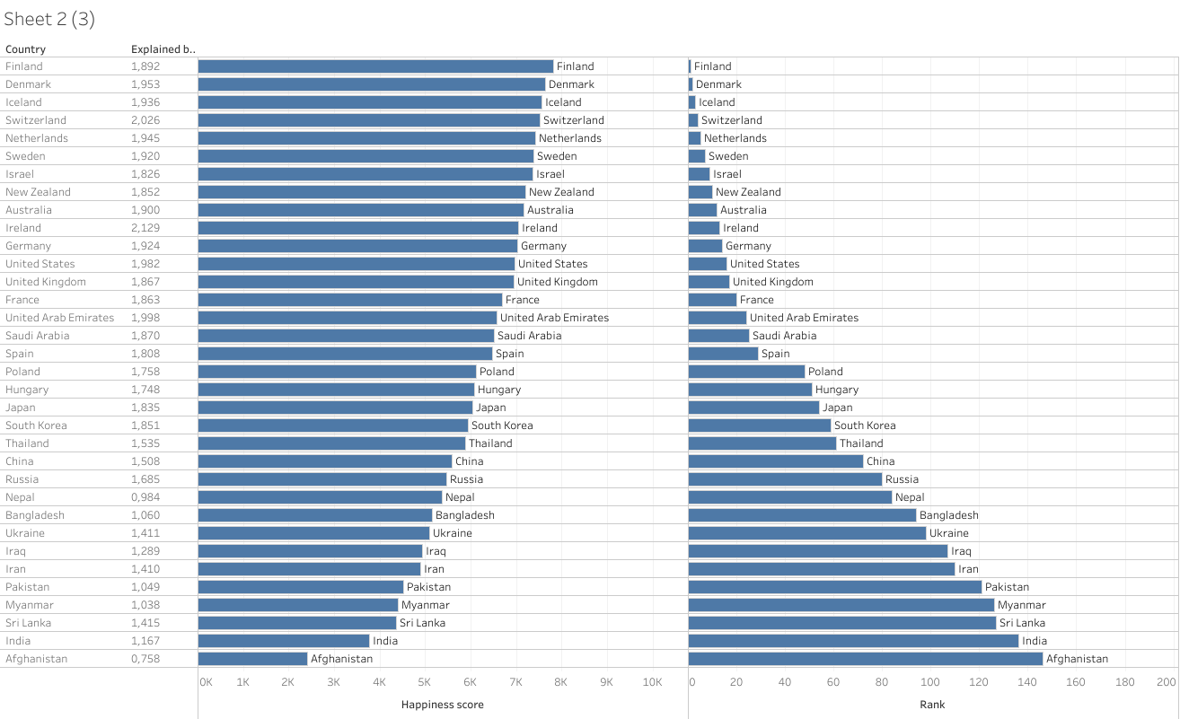
Let’s Analyse India’s Situation GDP Vs Happiness Score

Slide 9
GDP vs Happiness Score
We can see from the analysis that there is a general trend :High Gross Domestic Product of the Country ,high is the happiness score.
But it is does not seem true ,countries with low GDP per capita then India have higher happiness score than India ,eg : Myanmar, Pakistan ,Nepal
Also Countries with higher GDP per capita seems to be less happy than Countries with lower GDP, eg: USA has more GDP per capita than Finland but Finland is the world most happiest country
This tells us that it is certain that the richer is not necessarily the happiest. Therefore, besides income, there must be other important factors that contribute to people’s happiness besides money.

Slide 10
GDP vs Happiness Score: conclusion
One possible factor is income inequality, especially for more developed countries. Canada, Australia, and European countries such as Germany, Norway, Sweden, and Finland have lower income inequality and also have higher happiness indices compared to the United States. This raises an issue that although production is important, the allocation and distribution of the production is even more important.
Same is the case of India:According to the World Inequality Report 2022, the top 10 per cent of Indians had about 96 times more income on average than the bottom 50 per cent. Similarly, Oxfam International claimed that in 2021 India’s top 1 per cent owned about 77 per cent of the country’s wealth.
How we can improve ?
income disparity should be reduced, government should adopt Employment Programme and Wage Policies , Social Security Measures , Upliftment programme for Rural People

Slide 11
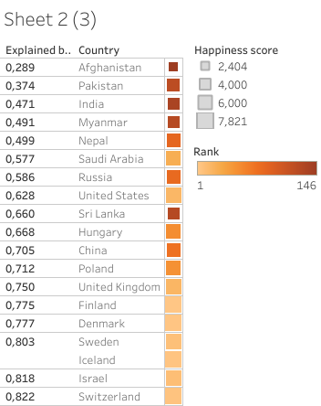
Healthy life expectancy at birth vs Happiness Score

Slide 12
Healthy Life Expectancy at birth vs Happiness Score
It is clear a more healthy a nation , a more happier it is , European countries have particularly invested on human development in terms of health as result they are the happiest.
But ,there has been only a marginal improvement in India's rank for Healthy Life Expectancy despite being a pharma capital of the world, growing medical tourism or an overall increase in healthcare facilities in the country.
What are the problems with health infrastructure of India ?
Skewed distribution of health facilities
Lack of manpower
Poor infrastructure
Low penetration of health insurance:

Slide 13
Healthy Life Expectancy at birth vs Happiness Score: Conclusion
How can we improve ?
Quantum increase in budget allocations
Better Health education
Primary health care need to be developed
Better health infrastructure required
Use of information technology to improve health

Slide 14
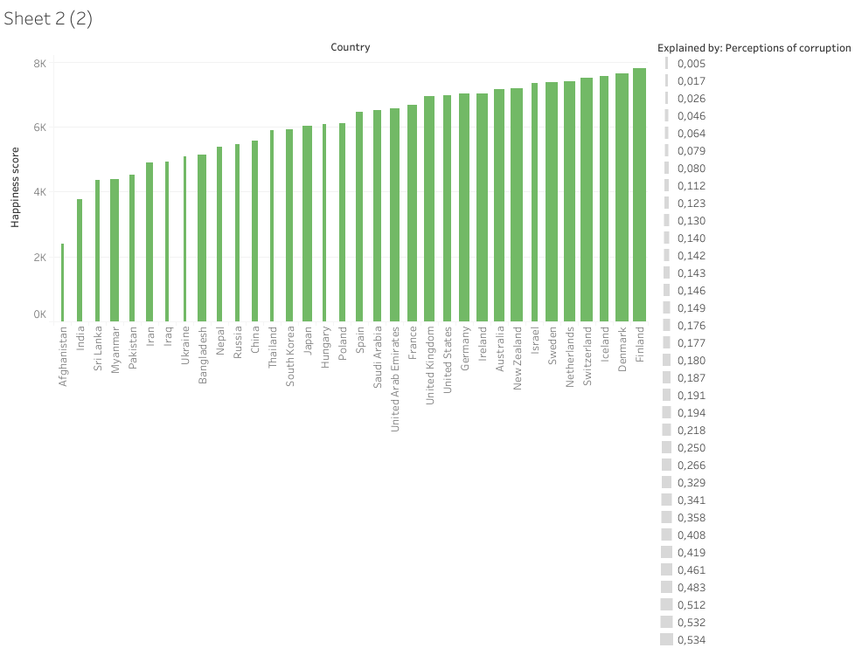
Perceptions of corruption vs Happiness Score

Slide 15
Perceptions of corruption vs Happiness Score
The countries with the best scores worldwide (and least corrupted) are Denmark in the first place, followed by New Zealand, Finland, Singapore, Sweden, Switzerland, Norway, Netherlands, Luxembourg, Germany, Iceland and Canada.
There is a very strong inversely proportional relationship between low levels of corruption and happiness in the population of a nation.
India is still a long way from being a corruption-free country
As per a research conducted by Transparency International in 2005, more than 62 percent of Indians have paid a bribe to a public official at some time in their lives. Another report from 2008 found that about half of Indians had first hand experience paying bribes or using contacts to get services from government agencies;
Corruption is a serious economic issue as it adversely affects the country’s economic development and achievement of developmental goals. It promotes inefficiencies in utilisation of resources, distorts the markets, compromises quality, destroys the environment and of late has become a serious threat to national security. It adds to the deprivation of the poor and weaker sections of the economy.

Slide 16
Perceptions of corruption vs Happiness Score-Conclusion
Control political financing to prevent excessive flow of money in politics.
End preferential treatment to ensure that the provision of services and the distribution of public resources do not respond to personal connections or are biased towards certain interest groups.
Promotion of transparent and broad access to decision-making processes.
Strengthen electoral integrity, prevent and punish deceptive campaigns.
Empower citizens, protect activists, informants and journalists.
Strengthen control systems and promote separation of powers.

Slide 17
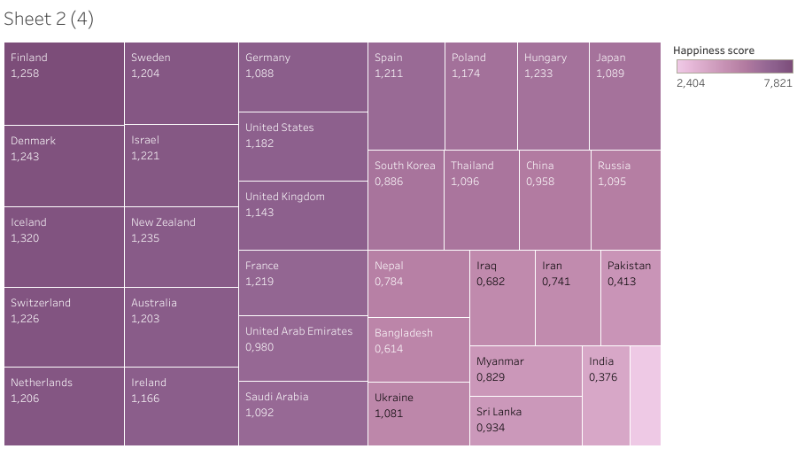
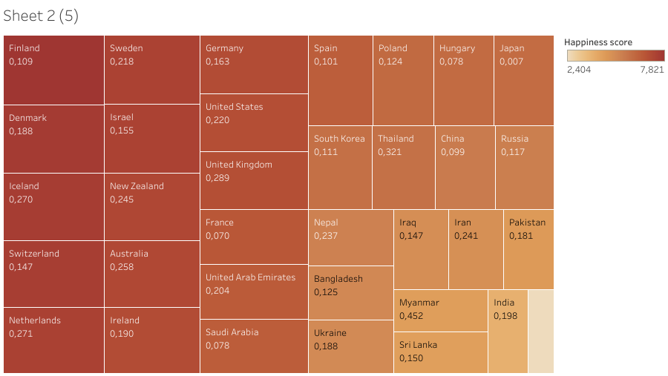
Social Support ,Generosity vs Happiness Score
Social Support vs Happiness Score
Generosity vs Happiness score

Slide 18
Social Support ,Generosity vs Happiness Score :Conclusion
Every year Finland scores high in all factors and especially high in the generosity factor. Nearly half of all people in Finland give money back to charity regularly and one-third of the Finish population volunteers their time.
Research on social support and happiness is reviewed. Research consistently finds that people who perceive their family and friends as supportive report greater happiness than those who doubt their social network’s supportiveness
Though Social Support and Generosity Scores are average for India but we can always do better.
Expanding Support to elderly ,women ,orphans ,homeless can make India’s position better.

Slide 19
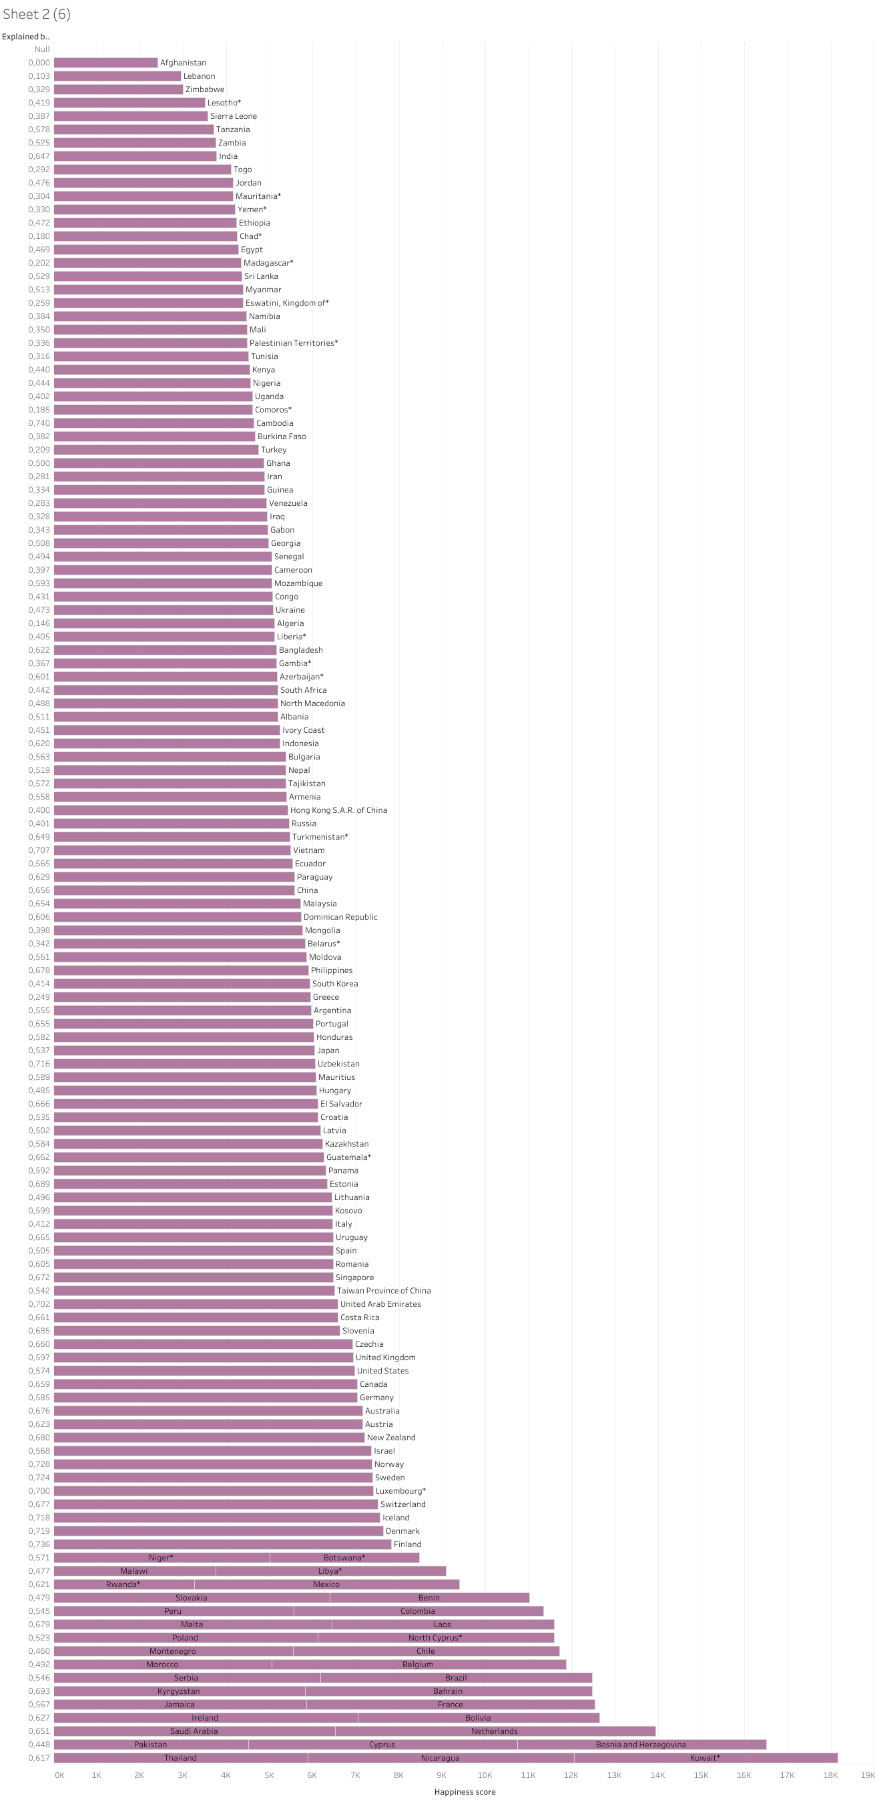
Freedom to make life choices vs Happiness Score
India

Slide 20
Freedom to make life choices vs Happiness Score
“Freedom to make life choices” is the national average of responses to the question “Are you satisfied or dissatisfied with your freedom to choose what you do with your life?”
More Freedom ,More Happiness
Freedom is important in terms of its consequences – personal freedom entails that people are free to do things that they find value and happiness in as long as they respect the rights of others, and economic freedom is the greatest explanator of prosperity (another determinant of happiness).
Happiness and freedom are very virtuous, but if they are to come at the expense of rights and freedoms of others, there would be few things more vicious.

Slide 21
Conclusion of Report
The report, through some simple statistical analysis, tries to find to what extent each factor determines the happiness that they have measured. Happiness in India, in 2022, was explained mostly by ‘GDP per capita’ at 31%, then by ‘freedom to make life choices’ at 17%, and least by ‘perceptions of corruption’ at 3%. Note that the national happiness figure is not an actual combination of the factors, but is measured independently, unlike indices where the quantities of the factors are either added or multiplied to arrive at a total index value.
With the combined measures of Government and we has a citizen ,we could improve our ranking and can become the World Happiest Country.
I am presenting a project which predict the world happiness ranking and how can Indians become happy ?

Slide 22
Project Title: How can Indians become Happy?

Slide 23
Problem Statement:
World Happiness Prediction with special emphasis on how can India Improve its Ranking ?

Slide 24
Objective:
My project has following goals:
1) It will try to predict happiness ranking of countries based on the given parameters
Gross Domestic Product Per Capita (Purchasing Power Parity).
Social Support.
Healthy life expectancy at birth.
Freedom to make life choices.
Generosity.
Perceptions of corruption.
2) It will try to analyze India’s situation and how can India improve its current ranking.

Slide 25


